Slide 1
VISVESVARAYA NATIONAL INSTITUTE OF TECHNOLOGY
BTECH FINAL YEAR PROJECT
GEAR FAULT DIAGNOSIS USING ADVANCED SIGNAL PROCESSING AND TSA METHOD
GUIDED BY
Dr. P. V. KANE
PRESENTED BY
JAYANT SATHAWANE
PARIMAL GAJBHIYE

Slide 2
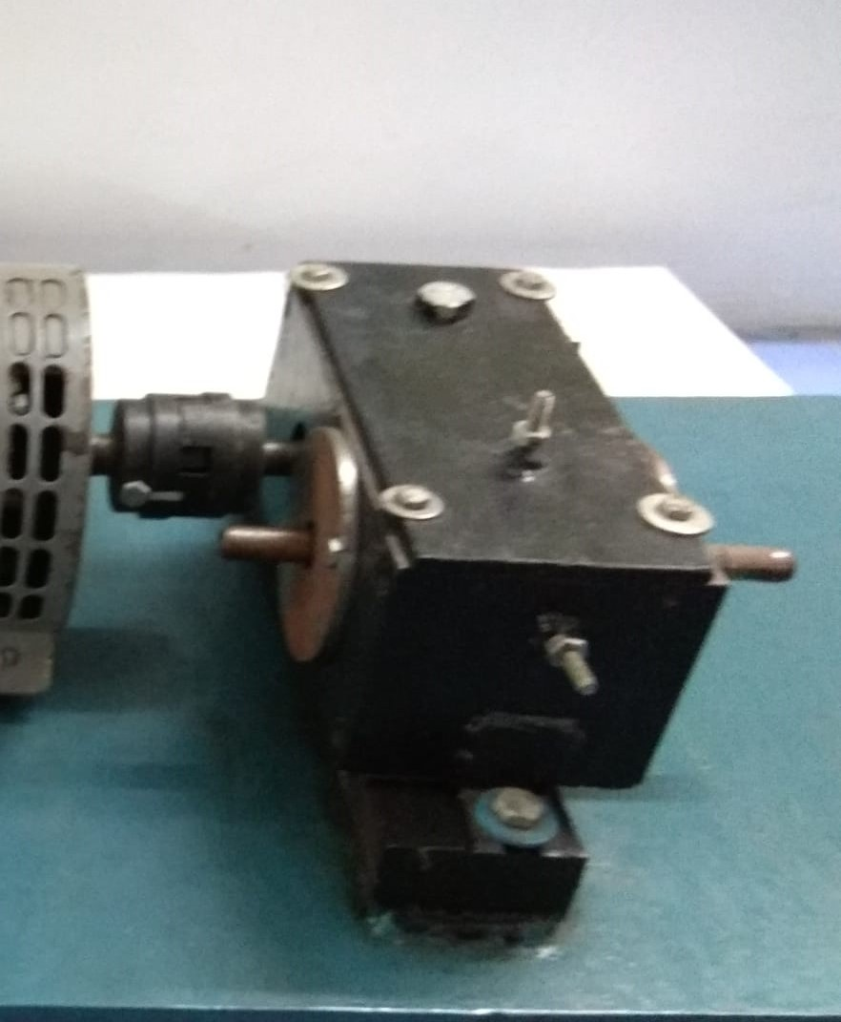
DATA ACQUISiTION
Setup consists of two identical pair of
shafts.
Number of teeth on gear is 46 and
pinion has 21 teeths and gear is rotating with
720 rpm.
Vibration and noise signal is acquired for
healthy and broken tooth condition.
Data of vibration for healthy condition is
taken with sampling frequency of 50 KHz and
taken with sampling frequency of 25 KHz for broken tooth condition
Whereas noise signal is taken with sampling frequency of 50 KHz .

Slide 3
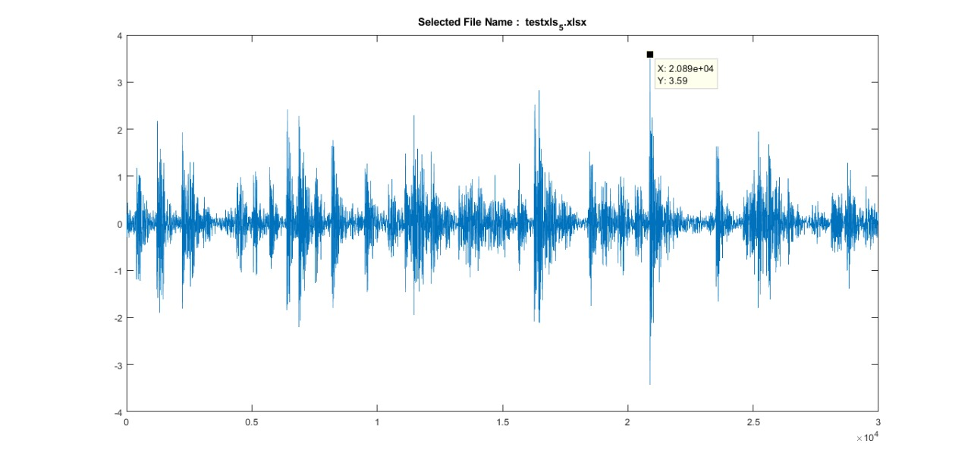
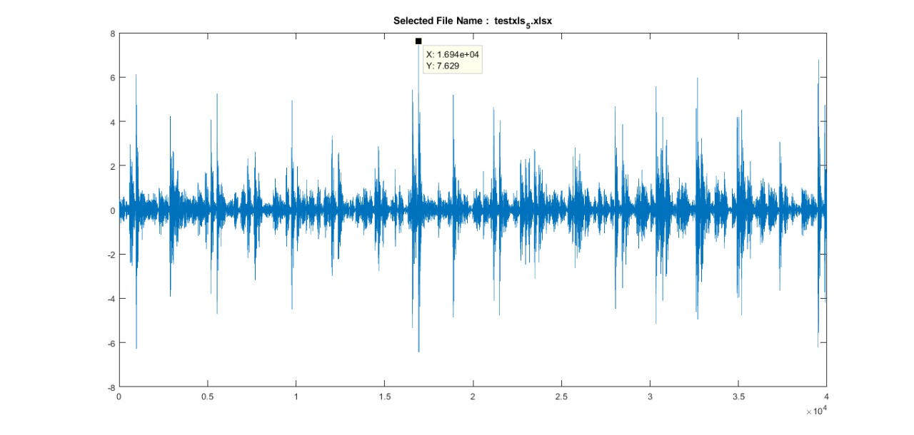
TIME DOMAIN SIGNAL
WAVEFORM OF VIBRATION SIGNAL
HEALTHY CONDITION BROKEN TOOTH

Slide 4
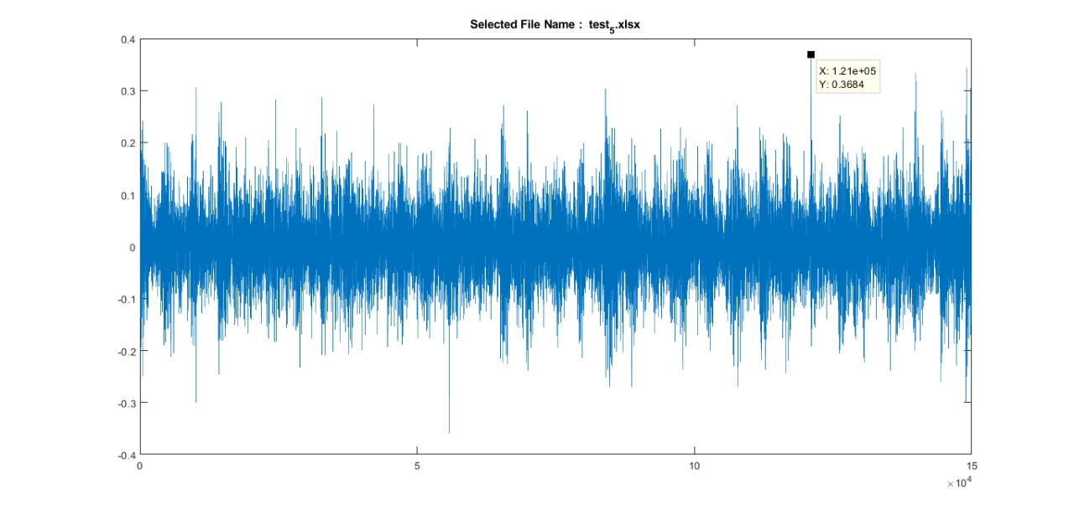
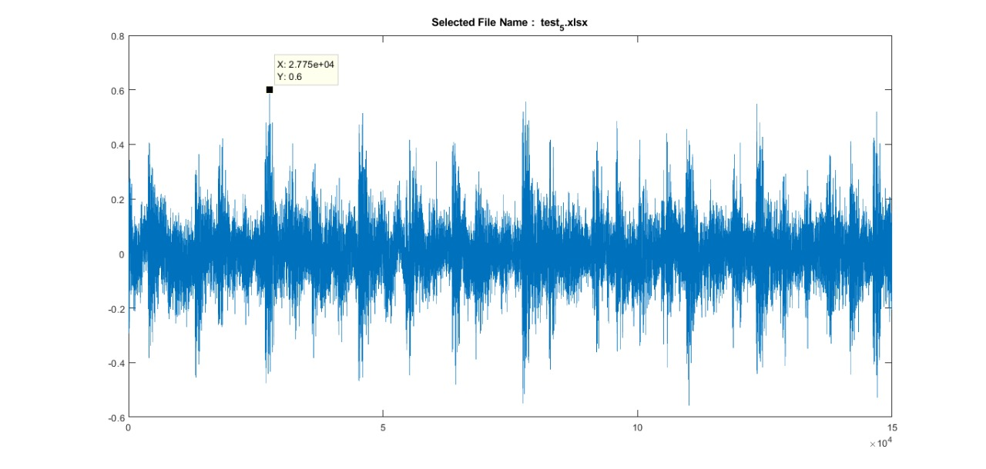
WAVEFORM OF ACOUSTIC SIGNAL
HEALTHY CONDITION BROKEN TOOTH

Slide 5
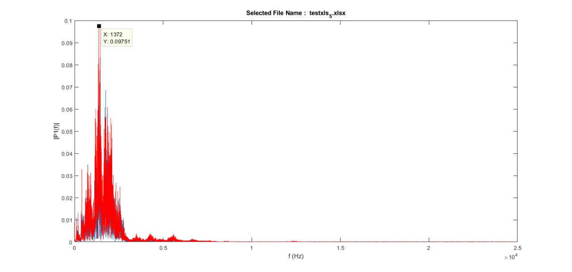
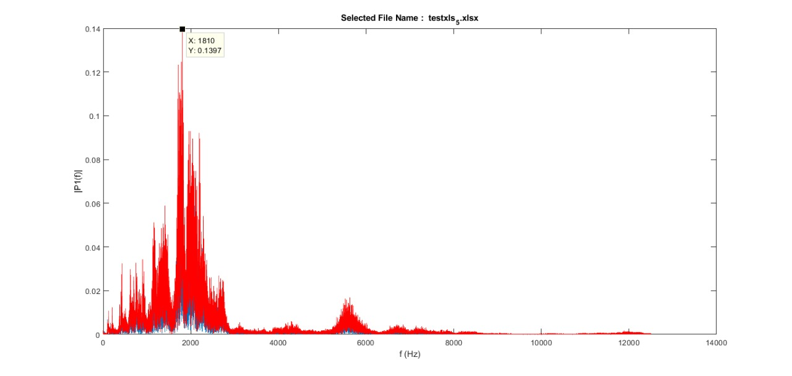
SPECTRAL ANALYSIS (FFT SPECTRA)
FFT SPECTRA OF VIBRATION SIGNAL
HEALTHY CONDITION BROKEN TOOTH
X 1810
Y 0.1397
X 1372
Y 0.09751

Slide 6
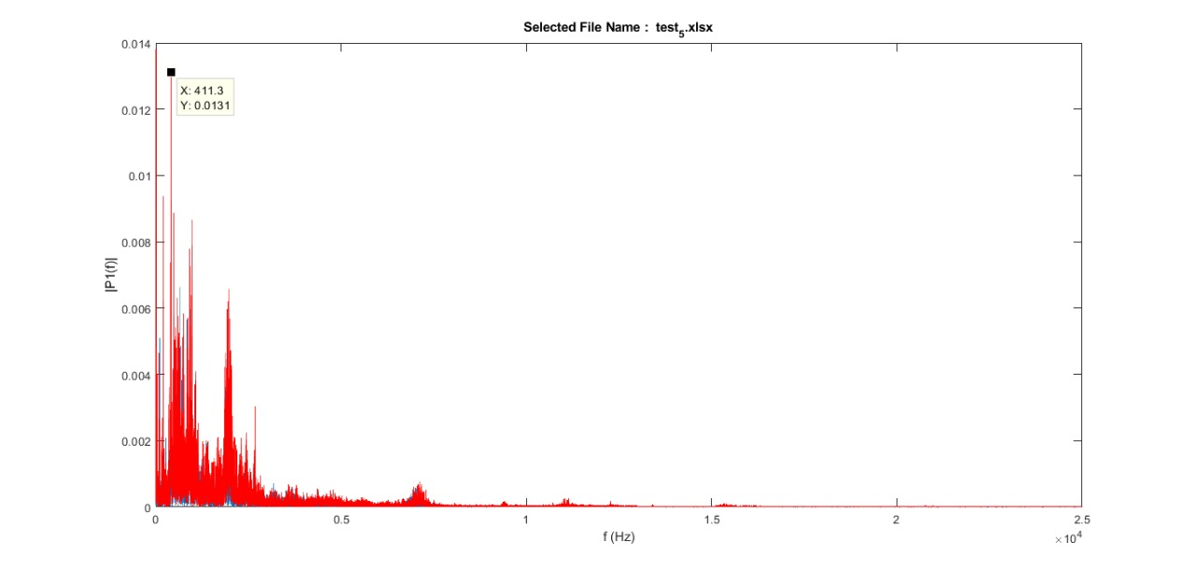
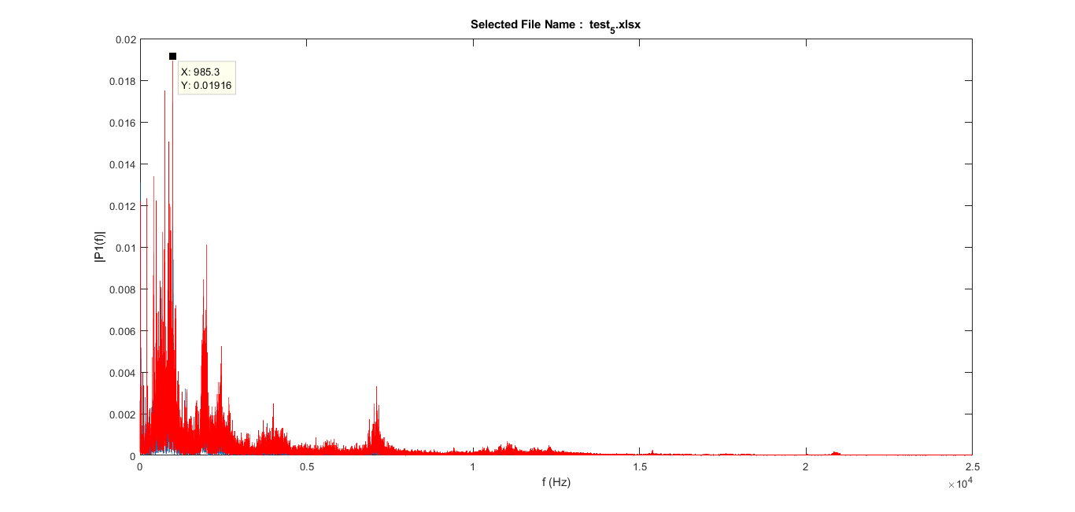
FFT SPECTRA OF ACOUSTIC SIGNAL
HEALTHY CONDITION BROKEN TOOTH
X:411.3
Y:0.0131
X:985.3
Y:0.01916

Slide 7
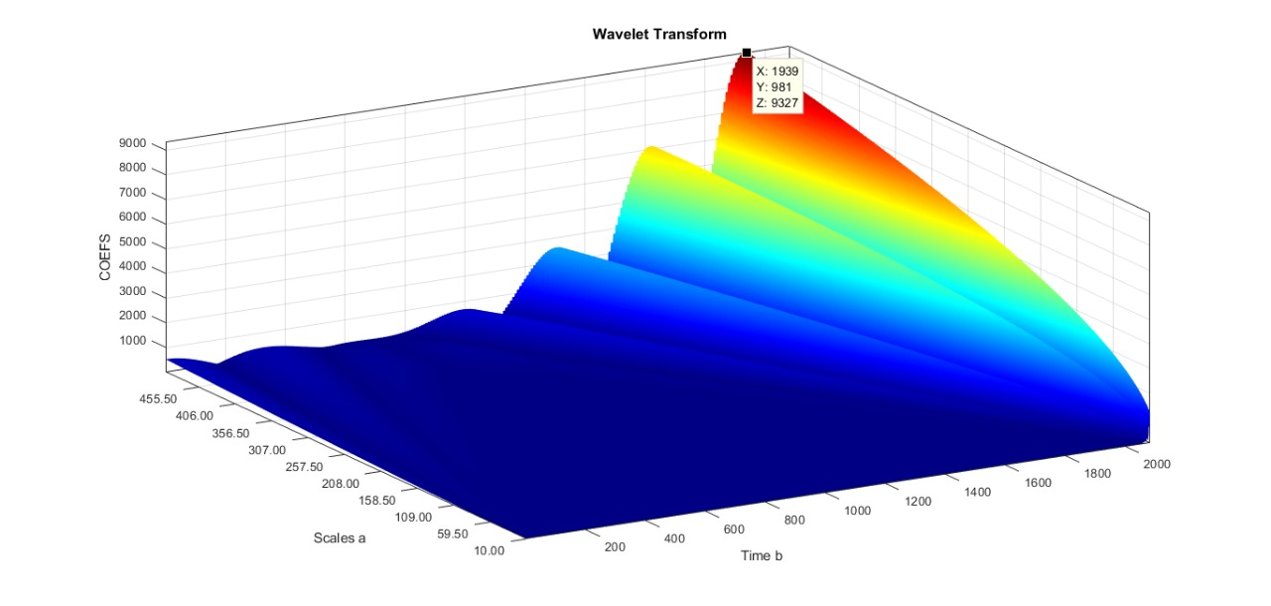
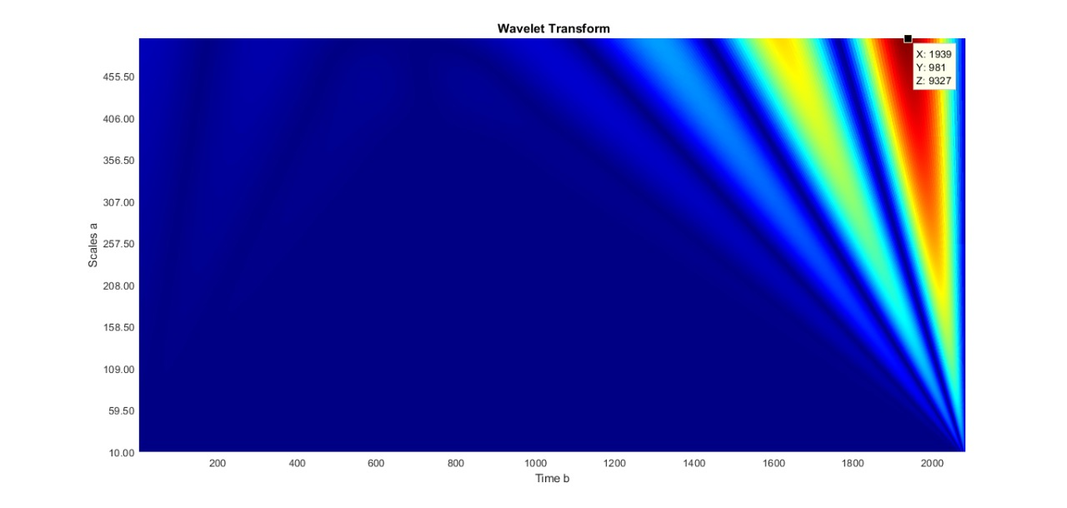
WAVELET TRANSFORM ANALYSIS
WAVELET PLOT OF VIBRATION SIGNAL FOR BROKEN TOOTH
X:1939
Y:981
Z:9327

Slide 8
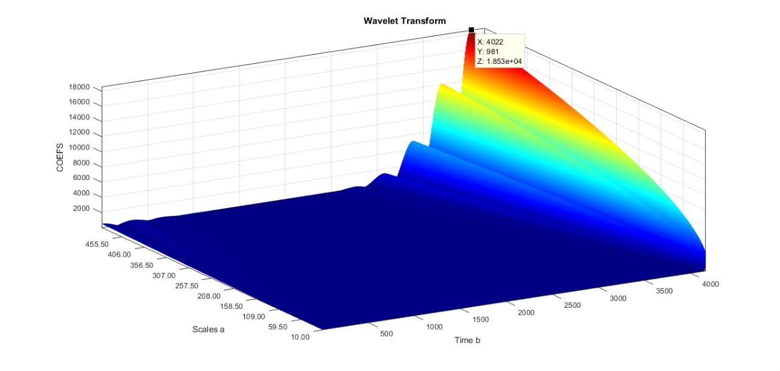
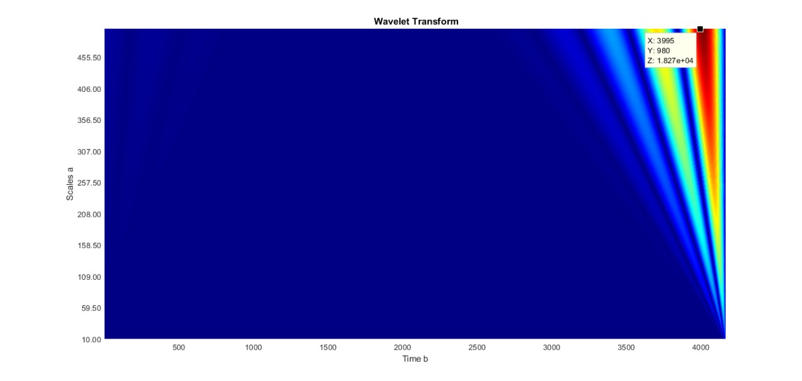
WAVELET ANALYSIS OF ACOUSTIC SIGNAL
WAVELET PLOT OF ACOUSTIC SIGNAL FOR HEALTHY CONDITION
X:4022
Y:981
Z:18530

Slide 9
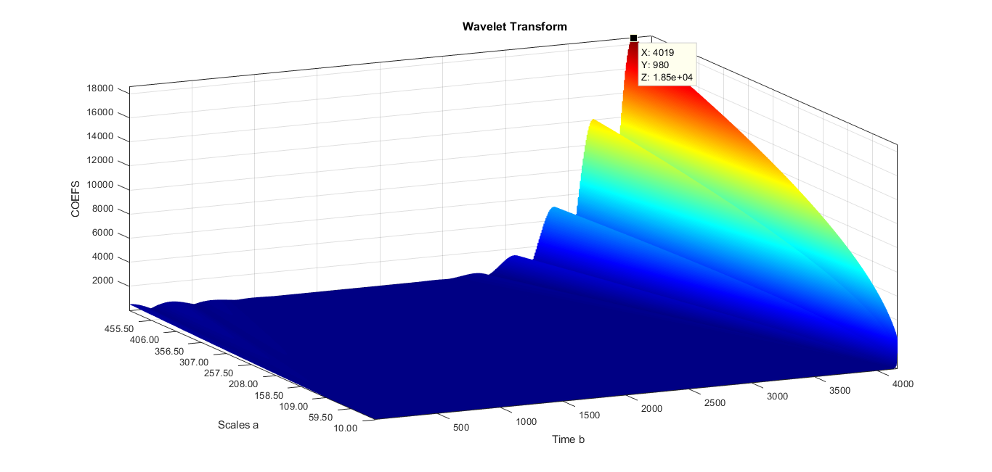
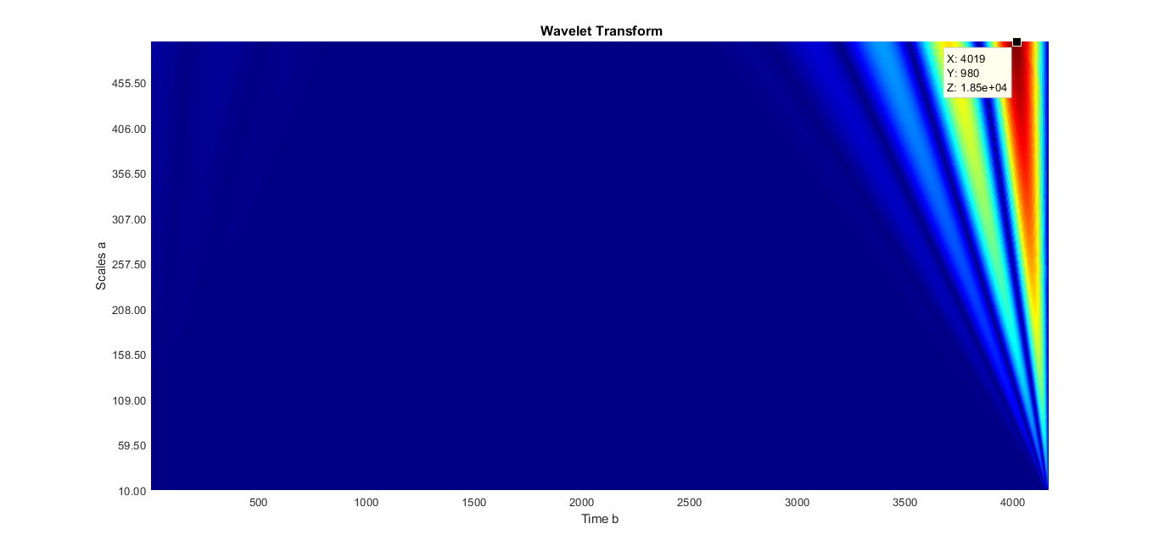
X:4019
Y:980
Z:18500
WAVELET PLOT OF ACOUSTIC SIGNAL FOR BROKEN TOOTH

Slide 10
For this wavelet analysis MORLET wavelet is used .
Other wavelets which can be used are
HAAR
SYMLETS
MEXICAN HAT
MEYER
COIFLETS

Slide 11
WORK REMAINING
CEPSTRUM ANALYSIS OF THE SIGNAL
USING OTHER TYPES OF WAVELETS AND FINDING BEST SUITABLE TYPE.
PERFORMING ORDER ANALYSIS ON THE SIGNAL
USING ANN METHOD FOR FAULT DETECTION .

Slide 12
THANK YOU

